Slide 1

Raspberry Pi/ SenseHAT Introduction
Frank Walsh

Slide 2

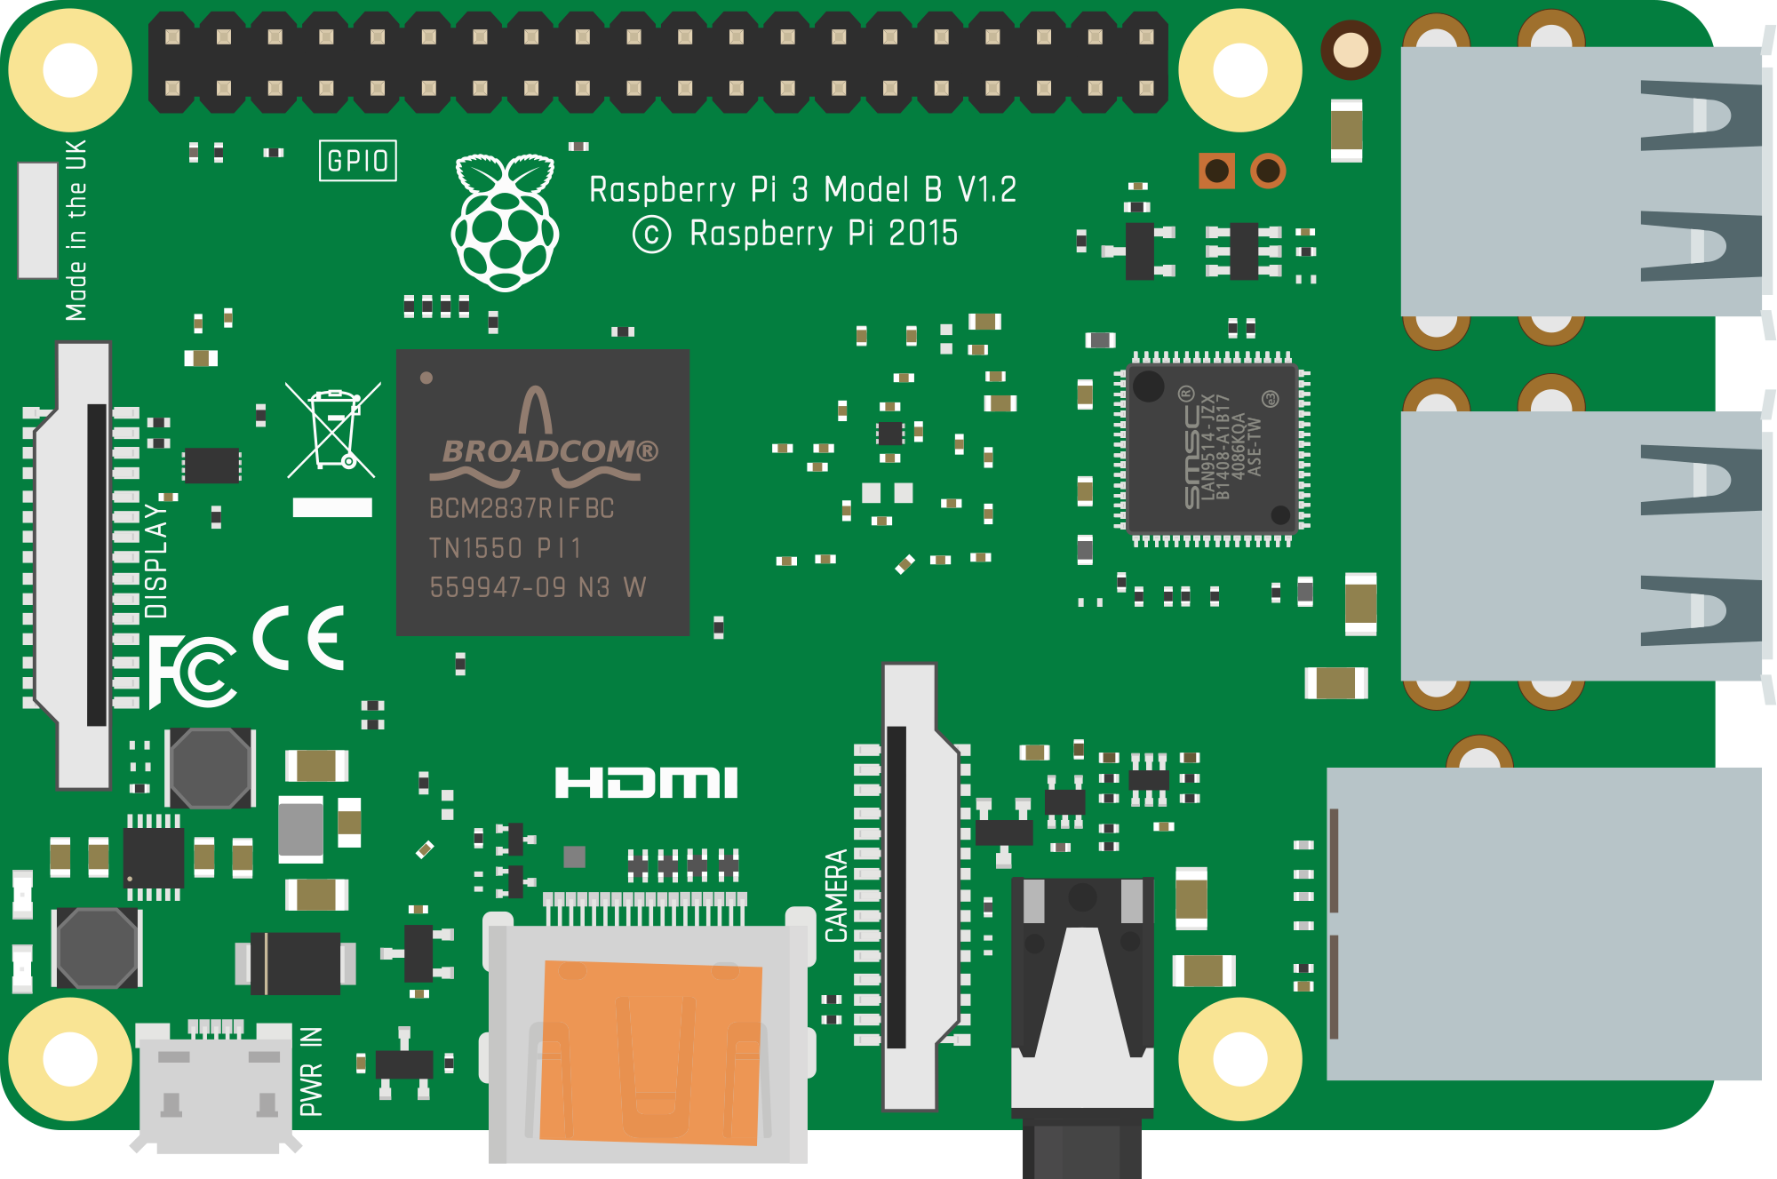
What is a Raspberry Pi?
Low cost, single board computer
Same features as most laptops/workstations
40 pin GPIO
USB Ports
LCD Display
RJ45 Ethernet
Power
HDMI
3.5mm audio

Slide 3
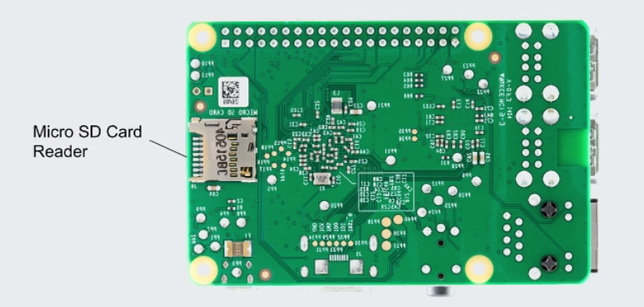
Raspberry Pi - Storage

Slide 4
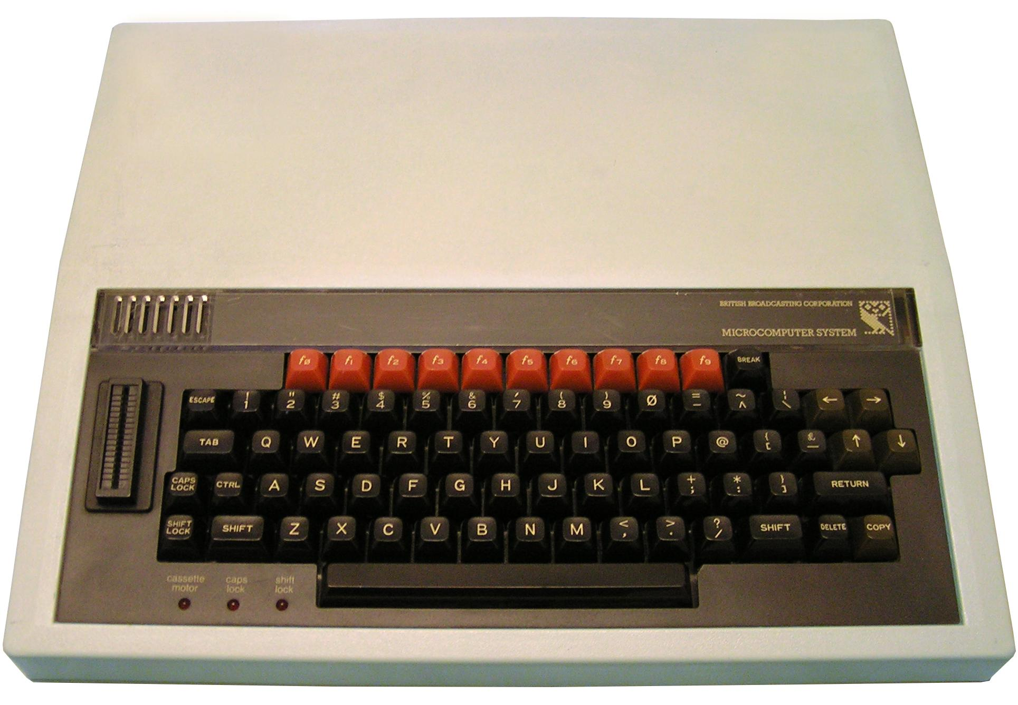
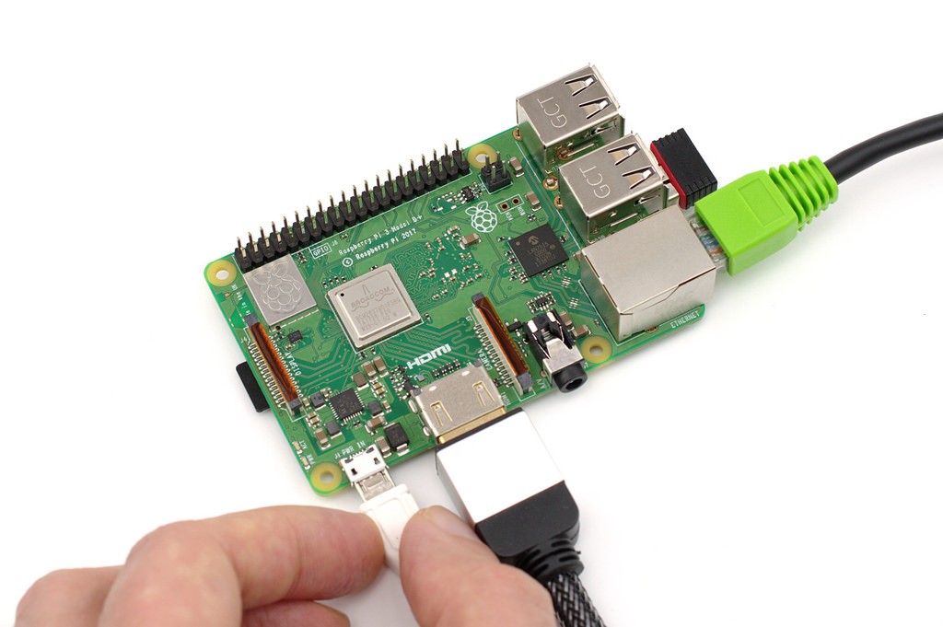
History
1981
Launched in 2012
Inspired by Acorn's BBC Micro from 1981
Original concept to inspire/educate kids
Used a lot in 3rd level/home
2016

Slide 5
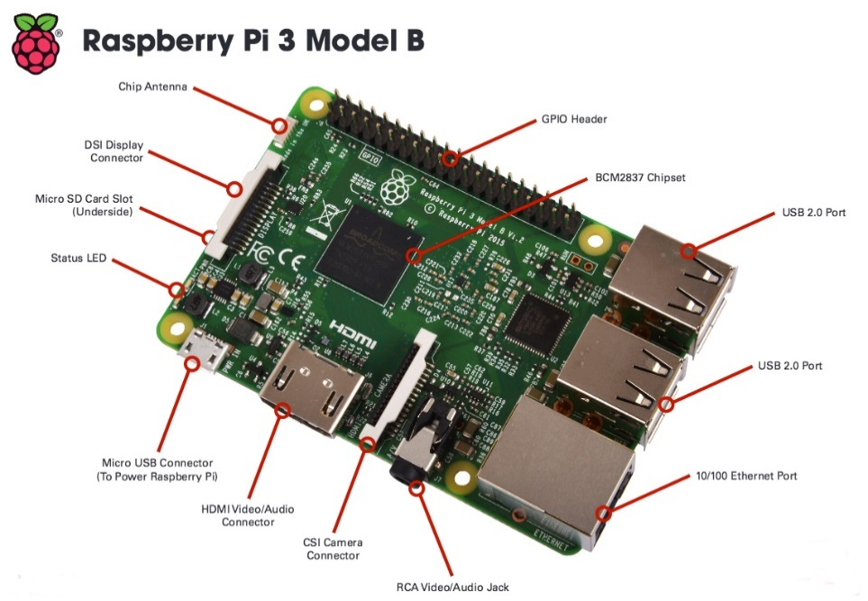
Raspberry Pi - Hardware
Processor and Memory (for pi 3 B+)
Broadcom 2836 System On Chip
64 bit ARM RISC CPU core (not x86 compatible)
Videocore IV GPU
Default clock is 1200Mhz. Overclocking not permitted in Rpi-3
GPU is basically as powerful as what was on the original Xbox
Mass Storage: micro SD card
Any SD card
Kernel boots from SD card
Easy to access root FS on other device

Slide 6
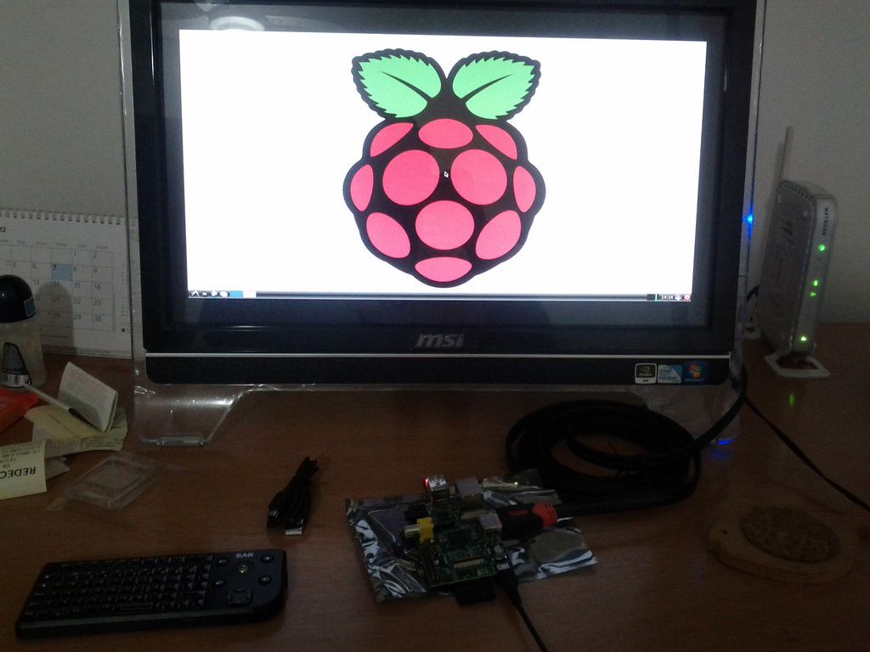
Getting Started -Conventional
Raspberry Pi 3 B
Keyboard and mouse
HDMI display monitor
SD Card (8 GB+ recommended)
SD Card Reader (usually a laptop)

Slide 7
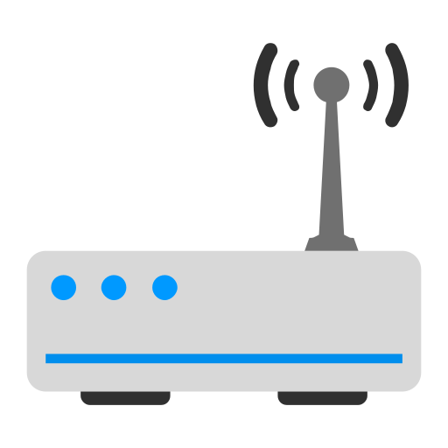

Getting Started –Headless
Raspberry Pi 3 B or higher
Keyboard and mouse
HDMI display monitor
SD Card (8 GB+ recommended)
SD Card Reader (usually a laptop)
Accessible WiFi network
SSH

Slide 8
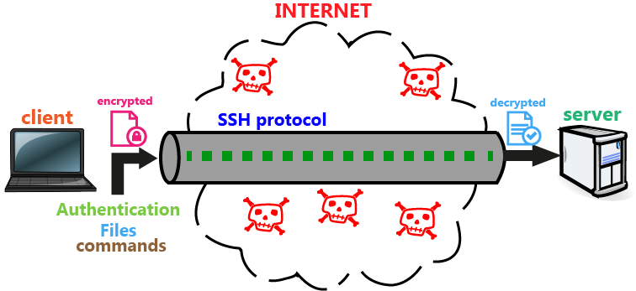
Secure Shell (SSH)
Cryptographic Network Protocol for operating over an unsecured network.
Typically used for remote command-line, login, and remote command execution.
Can use with Rpi to remotely log in/open remote terminal
Can also set up Routers/Switches with SSH to remotely configure them.
Replaces unsecure Telnet
In our mode of operation, use automatically generated public-private key pairs to simply encrypt a network connection.
list of authorized public keys is typically stored in the home directory of the user that is allowed to log in remotely.
This Photo by Unknown Author is licensed under CC BY-SA-NC

Slide 9
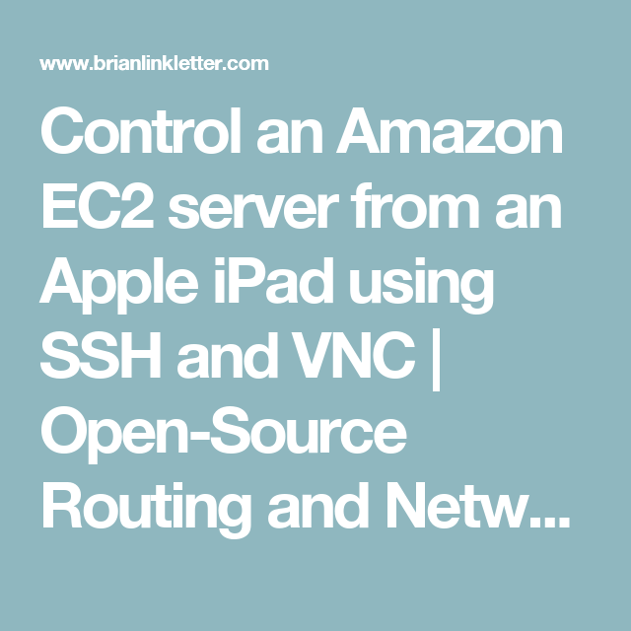

SSH:
SSH is present on most Operating Systems
MAC, Linux, Windows 10+
SSH widely used in Cloud Computing
Access remote VMs in the cloud using SSH
You will see it again in Dev Ops
https://www.youtube.com/watch?v=Atbl7D_yPug
https://www.linode.com/

Slide 10
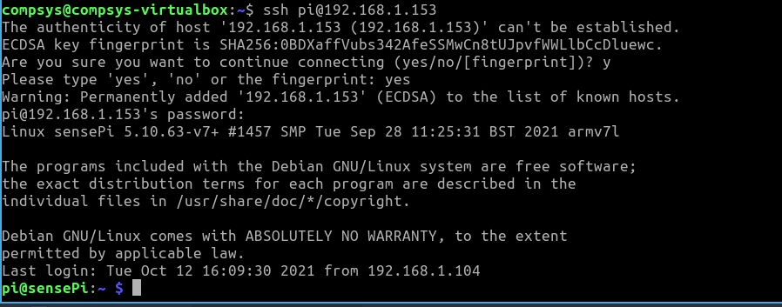


Using Secure Shell
If it’s the first connection between the host and the server, you will be prompted with the remote host's public key fingerprint and prompted to connect, despite there having been no prior connection:
At command line, connect to remote server using ssh command with user name and address(either IP or Domain Address) of remote server:
ssh UserName@SSHserver.com
ssh pi@10.1.1.234

Slide 11
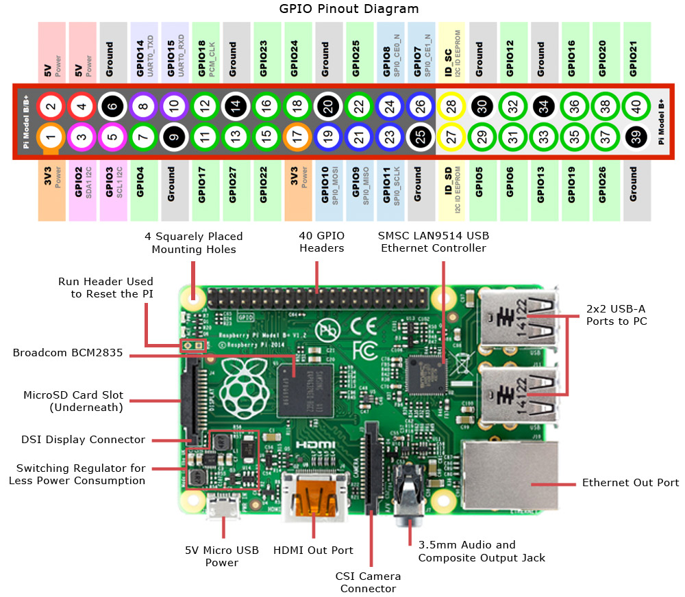
Raspberry Pi - Hardware
General Purpose I/O (GPIO)
3.3 volt logic via 40 pin header
NOT 5 volt or short tolerant
Parallel I/O pins
UART (Linux console support)
I2C, SPI for peripherals
No Analog to Digital/D, so no analog input
Can do software-based PWM
Libraries exist for interacting with the GPIO through several programming languages
More I/O
Display Serial Interface (DSI) LCD panel support
Camera Serial Interface (CSI) camera support

Slide 12
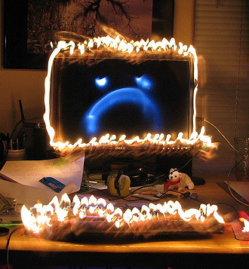
Warning - Don't fry your RPi
RPis are fairly robust but...
If using with keyboard/screen
Connect the USB keyboard and USB first
Connect the HMDI connector
Turn on the monitor
Plug in the power cable
Do not plug in the SenseHat when the RPi is plugged in and booted into Raspian.
ALWAYS plug in the HAT before plugging in the power cable.

Slide 13
Warning - Don't fry your Rpi Physical Stuff….
If you're doing some "physical computing"
Input no more that 3.3V to a GPIO
Use GPIO.cleanup() to set the GPIO pins back to a safe state; input only
Current load should be less than 16mA on any one GPIO pin
Current load should be less than 100mA for all GPIO pins
Do not connect a motor directly to the Pi's GPIO, the back EMF(Electromotive Force) will fry the Pi;
Use a transistor

Slide 14
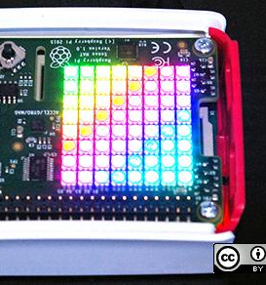
SenseHAT
HAT stands for Hardware Attached on Top.
Several HATs available for RPi.
These are external boards you can purchase that plug right into the GPIOs.
We're using SenseHAT
8×8 RGB LED matrix
five-button joystick and includes the following sensors:
Gyroscope
Accelerometer
Magnetometer
Temperature
Barometric pressure
Humidity
Also a Python library provides an easy programmatic interface to everything on the board.

Slide 15
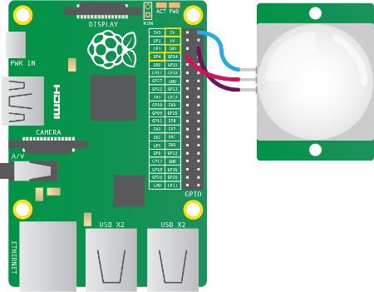
Other things you can do with RPi – Physical Computing
Can interface with many different devices/components
Use the GPIO pins on your Raspberry Pi to interface with electronic components, such as LEDs and PIRs.
Write programs that interact/control attached components

Slide 16
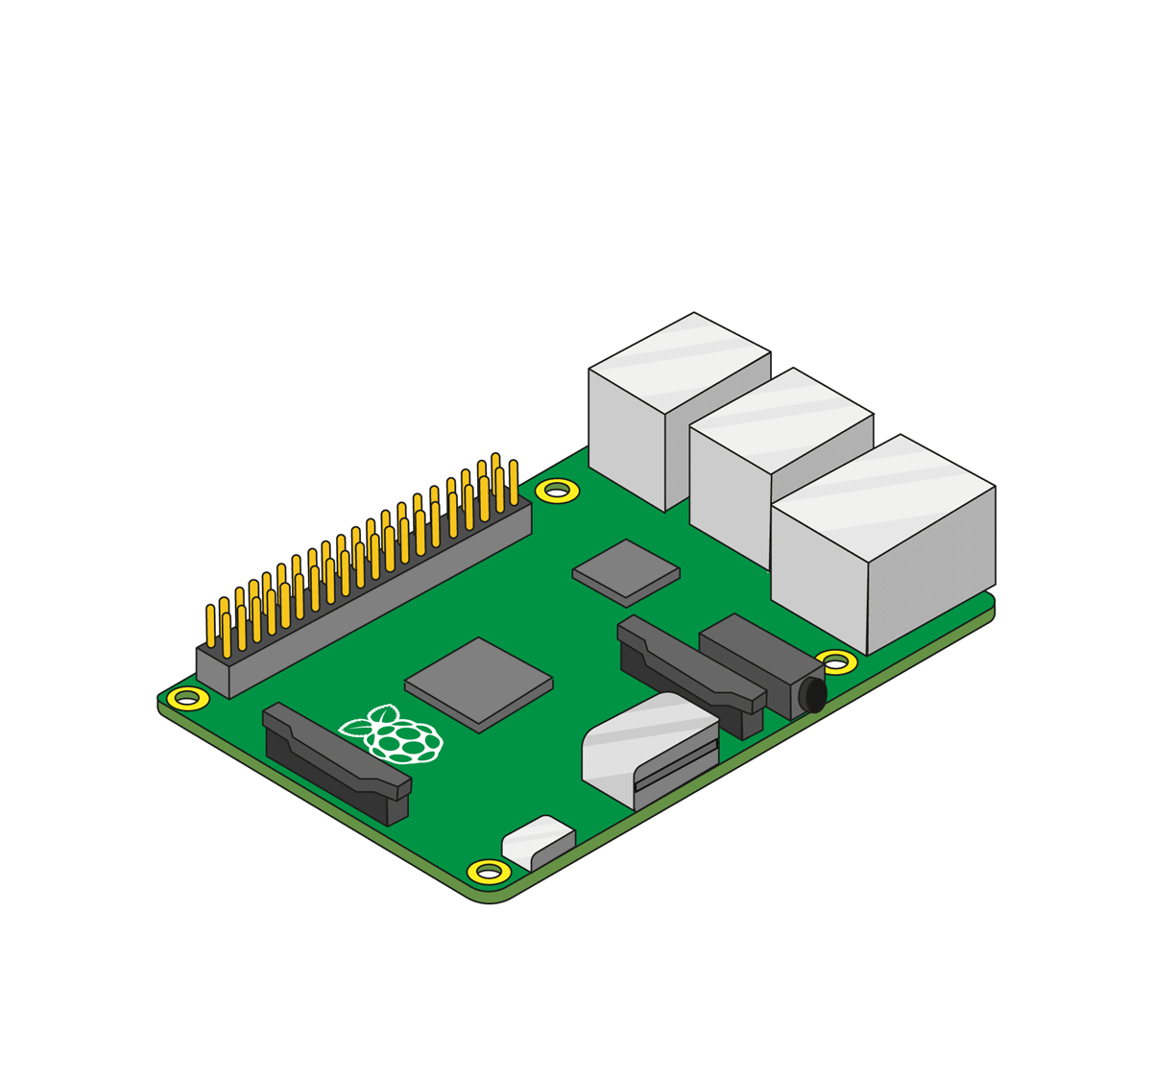
Setting Up Your Pi - Attaching the SenseHAT
Follow the instructions here: https://projects.raspberrypi.org/en/projects/getting-started-with-the-sense-hat/3

Slide 17





Setting up your RPi – Installing an OS
If you bought your RPi with a pre-installed SD card you're good to go.
If you have a blank SD card, do this weeks lab!
Supported OS
Raspbian (Debian optimized for Rpi)
Debian (non-optimized)
Arch Linux
RISC OS
NetBSD
Openelec – an XBMC media center
Pidora – Fedora remix

